Slide 1
Case Study: Design Slack

Slide 2
设计考虑的方面
Business(Use Cases) / Common Sense
Constraints
Architecture
API Design
DB Choice
Data Model

Slide 3
Slack相关
Domain / Group / Individual
Support direct msg / group msg
Support link preview
Support multimedia msg
Msg notification
Highlight unread msg

Slide 4
Use Case (discuss w/ interviewer)
MVP feature
Direct Message
Channel: Group Chat
Multimedia msg
Link Preview
Goal:
HA
High reliable
Consistent
High Performance – real time
Bonus feature
Group Membership
Msg Notification
Highlight unread msg
Non–Goals (Assumption)
Authentication / Authorization
Mobile / Web multi ends

Slide 5
Constraints
(Ask interviewer) DAU: 10M
MVP
Peak direct message: 5 * 10M * 100 / 86400 = 50K msg / s
1 msg: 100 bytes
Throughtput: 500K * 100 / 1000 = 100 MB / s
Storage: 100 MB * 86400 = 10 TB
Group chat #: 1000 members in a group
Scale
QPS (> 1000, partition)
Data

Slide 6
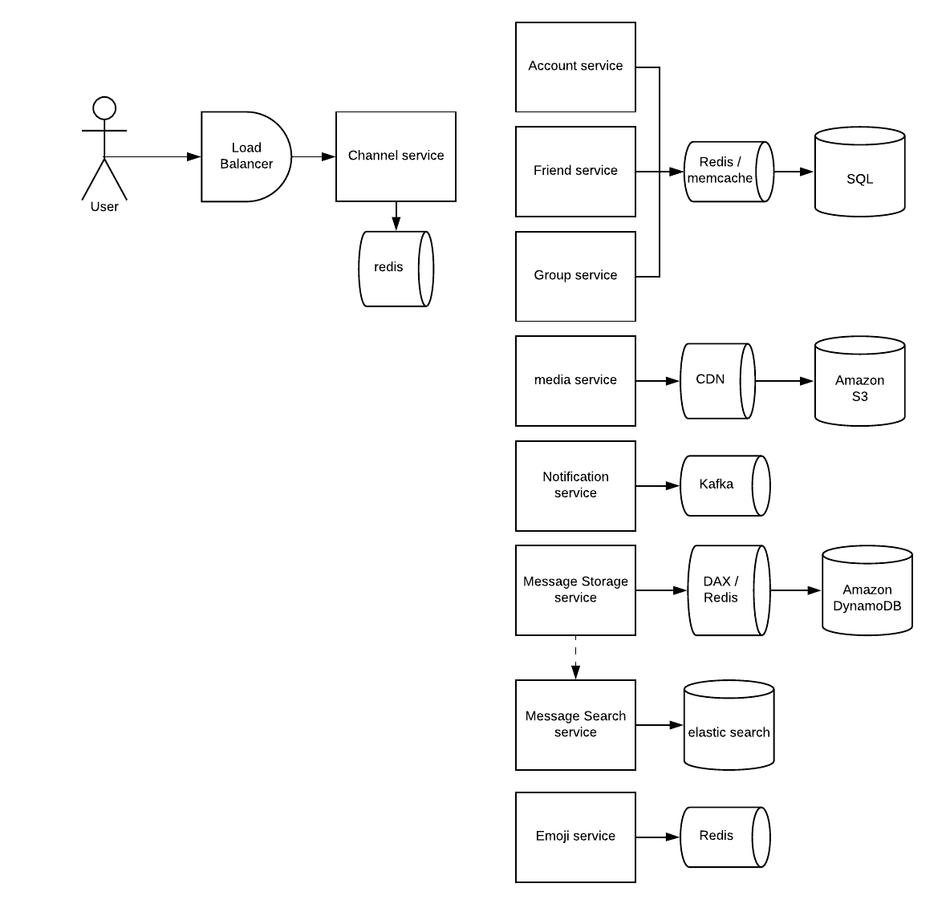
Architecture

Slide 7
API
GetChannels(user_id):
Store last viewed channel
Store visible channels: recent direct message/membership of the group
Show unread msg / last msg preview: denormalized data
SendMessage(Sender_id, receiver_id, message_type, message, media_id)
message_type is one of [direct message, group message]
create_timestamp, update_timestamp, expired_time, STATE will be appended by channel service.
STATE could be one of [received, sent, viewed,notification_sent, deleted], the multimedia message may need to be processed, therefore need some time between received and sent
updateMessage(message_id, message) / deleteMessage
uploadFile(user_id, permission_group, file_descriptor, some_metadata)
LookupEntity(user_id) – trie
joinGroup(user_id, group_id)
getDirectMessages(user_id, friend_id)
getGroupMessages(user_id, group_id)
CRUD for group info
getGroupNotice / getGroupMembers / getGroupDetail / GetGroupSharedFiles / update...
CRUD for user info
getUserInfo / updateUserInfo

Slide 8
Internal API
Media service:
processMedia(media_id)
Replicate media
Post-processing: Generate preview / thumbnail
Distributed to CDN
Notification Service:
notifyUser(user_id, sender_id, message_id, msg_preview);
Either use database or Kafka
Exactly once is difficult, requiring two-phase commits.

Slide 9
Data Model

Slide 10
Bottleneck & Scale

